Slide 1


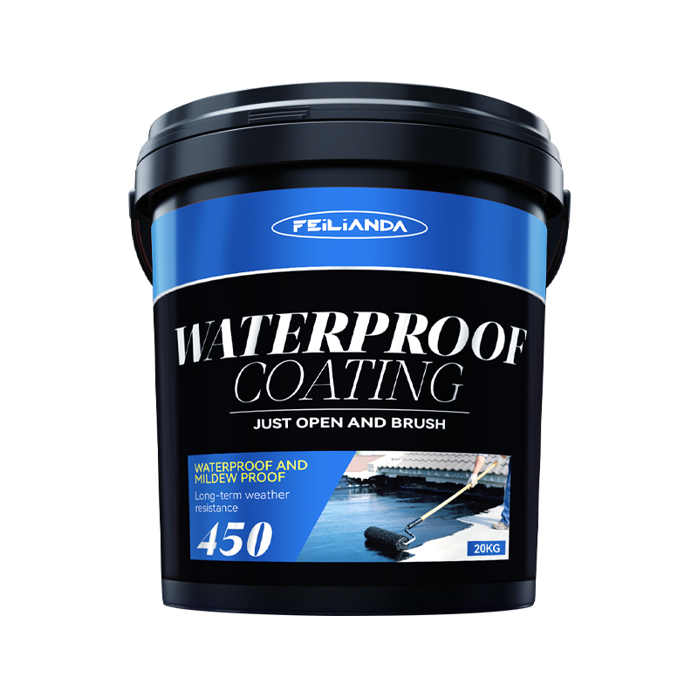
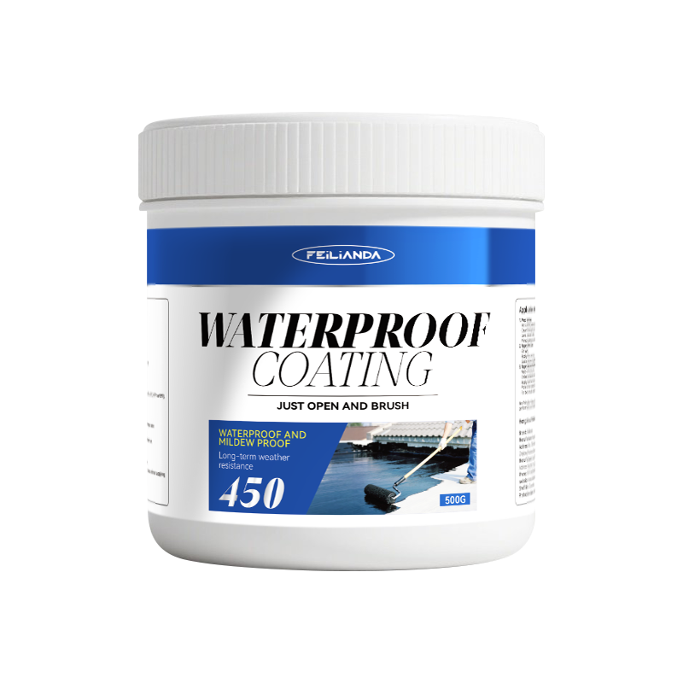
Datasheet
CONSTRUCTION
SOLUTIONS
WATERPROOFING
LAB™
450 FEILIANDA 450 Waterproof Coating
Product Overview and Image
FEILIANDA 450 Waterproof Coating is a high-performance water-based waterproof coating designed for long-term waterproofing of various building surfaces. Its formulation contains a high proportion of acrylic emulsion, which significantly improves film formation, elasticity, and adhesion. Suitable for both new construction and renovation projects, it performs excellently in situations requiring reliable moisture resistance and durability.
Features and Benefits
• High emulsion content: Enhances coating density and continuity, delivering excellent waterproof performance. • Excellent elasticity: Accommodates minor structural movement without cracking. • Strong adhesion: Bonds well with concrete, masonry, wood, metal, and other common substrates. • UV resistance: Maintains color stability and physical properties under sunlight exposure. • Smooth application: Can be easily applied with conventional tools for a uniform surface finish.
Uses
This coating is suitable for waterproofing and protective sealing of roofs and rooftops: • Roofs and balcony platforms
Version 3.2 of Datasheet 450 approved on Monday, 23 March 2026, 14:05:32 P.M. UTC+8
Page 1 of 4

Slide 2
Datasheet
CONSTRUCTION
SOLUTIONS
WATERPROOFING
LAB™
Typical Properties
Sizes: This product is packaged in drums, with sales packaging specifications available in four sizes: 0.5KG / 5KG / 10KG / 20KG.
Available Colors: Black White Blue Gray
Clean Up: Skin Contact: Immediately wash thoroughly with soap and plenty of warm water. Avoid using solvents or harsh chemicals on skin. If irritation persists, seek medical advice. Eye Contact: Rinse eyes cautiously with clean running water for at least 15 minutes, lifting upper and lower eyelids occasionally. Remove contact lenses if present and easy to do. Seek immediate medical attention.
Application Methods: Brush coating (for precision areas and corners) Roller coating (for large flat surfaces) Spray coating (using airless or pneumatic spray equipment for uniform coverage
Drying Time: Initial Set / Touch Dry: 2–4 hours Walkable: 24 hours Full Chemical & Mechanical Cure: 2–5 days Note: These times vary with temperature, humidity, and layer thickness.
Coverage Area: 1 kg of the product is expected to cover an area of approximately 2 square meters.
Construction Steps: Surface preparation – Ensure the substrate is clean, dry, and free of dust, oil, grease, loose particles, and other contaminants. Cracks larger than 0.5 mm should be repaired before coating. Mixing – Stir thoroughly before use to avoid introducing bubbles. First coat – Evenly apply with a brush, roller, or spray equipment according to the manufacturer’s thickness requirements. Second coat – Apply after the first coat is dry to the touch (at least 2–4 hours); the application direction should be perpendicular to the first coat for optimal coverage. Inspection – Check for pinholes or uncoated areas and repair promptly. Final curing – Wait for complete curing before the surface contacts water or bears mechanical loads.
Maintenance Precautions
Regularly check the coating surface for damage, wear, or cracking. Minor damage can be repaired by cleaning the affected area and applying one or two coats of the same coating. Avoid using strong chemical cleaners that may damage the coating film.
Version 3.2 of Datasheet 450 approved on Monday, 23 March 2026, 14:05:32 P.M. UTC+8
Page 2 of 4

Slide 3



Datasheet
CONSTRUCTION
SOLUTIONS
WATERPROOFING
LAB™
Technical Parameters*
Appearance: The product is a uniformly viscous body, free from gelation, delamination, and caking.
Solid content (%): ≥65 (test value: 68)
Density (g/cm³): 1.422
Tensile properties (standard state): Tensile strength (MPa) ≥1.2 (test value: 1.4) Elongation at break (%) ≥300 (test value: 448)
Tear strength (N/mm): ≥12 (test value: 18)
Low-temperature bending: No cracks at -15°C
Surface drying time: ≤4h (actual test: surface dry at 4h)
Full drying time: ≤8h (actual test: fully dry at 8h)
Water impermeability: 0.3 MPa, 2 h, no water penetration
* Provided by China National Engineering Composite Materials Quality Inspection and Testing Center
Version 3.2 of Datasheet 450 approved on Monday, 23 March 2026, 13:55:22 P.M. UTC+8
Page 3 of 4

Slide 4
Datasheet
CONSTRUCTION
SOLUTIONS
WATERPROOFING
LAB™
Storage Conditions and Duration
Storage Temperature: Keep between +5°C and +45°C. Storage Environment: Store in a cool, dry, well-ventilated place away from direct sunlight and sources of heat. Packaging: Keep the product in its original sealed packaging to prevent contamination or moisture ingress. Shelf Life: 24 months from the date of manufacture when stored under recommended conditions. Safety Note: Keep out of reach of children and unauthorized personnel.
Disclaimer
This data sheet is copyrighted by Feilianda New Materials Co., Ltd. and/or Hangzhou Tianji Trading Co., Ltd. (collectively referred to as “Feilianda”). Without the prior written consent of Feilianda, this data sheet may not be modified or altered; if such modifications occur, Feilianda shall bear no responsibility or liability for them.
Unless Feilianda has provided you with a customized specification tailored to a specific project, this data sheet does not imply that any particular product or product system is suitable for your project.
All information provided in this data sheet is given in good faith, and Feilianda believes it to be correct at the time of publication. Provided that the substrate is in good condition, the coating is applied by personnel with appropriate experience and skills, and preparation, application, and maintenance are carried out strictly in accordance with the instructions or recommendations in this data sheet, the performance of the product and coating system is expected to meet the descriptions herein. Climatic conditions at the time of application may affect the suitability and performance of the product.
Correct color or color matching is the responsibility of the applicator. Colors may change over time, and Feilianda does not guarantee that a newly mixed color will match a previously applied color that has been exposed to weathering or other factors. No product color is guaranteed against color change.
To the extent that any liability of Feilianda related to this data sheet cannot be excluded by law, Feilianda’s liability, to the extent permitted by law and at its option, is limited to re-supplying the relevant products or services, or reimbursing the cost of such products or services.
Version 3.2 of Datasheet 450 approved on Monday, 23 March 2026, 14:05:32 P.M. UTC+8
Page 4 of 4

