Slide 1


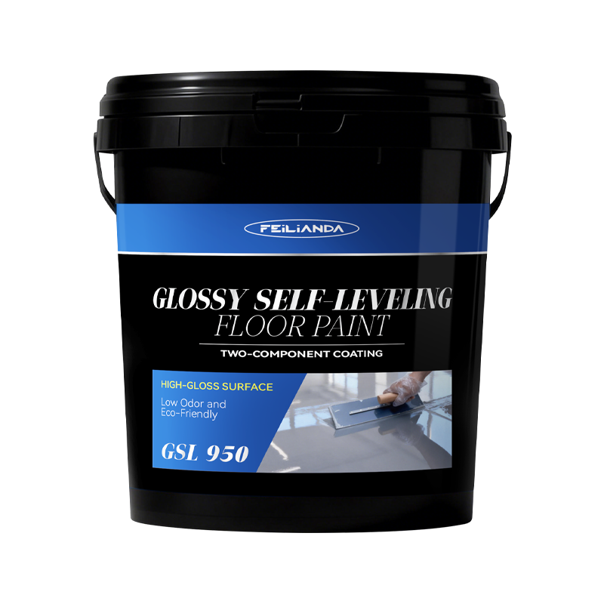
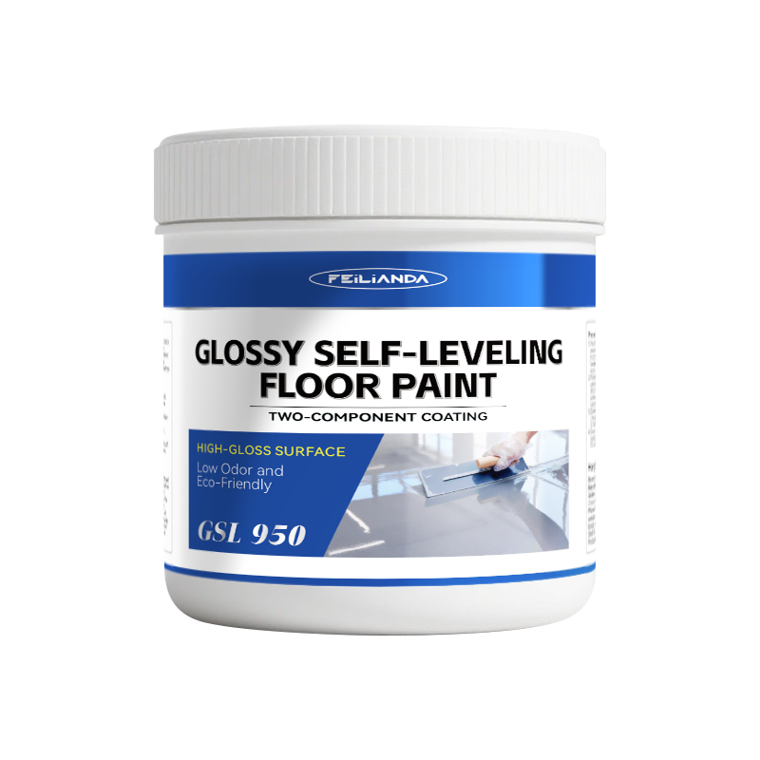
Datasheet
CONSTRUCTION
SOLUTIONS
DR. FLOOR PAINT
LAB™
GSL 950 FEILIANDA Glossy Self-Leveling Floor Paint
Product Overview and Image
FEILIANDA Glossy Self-Leveling Floor Paint is a high-performance ready-to-use flooring coating system based on advanced epoxy resin technology. It can form a smooth, durable, and seamless surface without the need for additional solvents or extensive manual leveling. The product cures through a chemical reaction rather than evaporation, ensuring a uniform paint film under different environmental conditions.
Features and Benefits
Solvent-Free Composition: Contains no volatile solvents, minimizing emissions during application and curing. Excellent Flow Properties: Naturally spreads evenly across substrates with minimal manual intervention. High Mechanical Strength: Provides abrasion resistance and impact durability suitable for industrial environments. Smooth Finish: Achieves a glossy or matte finish depending on formulation variants. Chemical Resistance: Resistant to oils, dilute acids, alkalis, and cleaning agents commonly used in commercial facilities. Rapid Surface Dryness: Allows foot traffic shortly after application while full cure develops over time.
Uses
Scenario Overview: Ideal for indoor flooring requiring a seamless, hygienic, and hard-wearing surface. Commonly applied where cleanliness, aesthetics, and durability are priorities. Examples: Warehouses and logistics centers Manufacturing plants with moderate mechanical loads Commercial kitchens and food processing areas Exhibition halls and retail spaces Parking garages (interior sections)
Version 3.2 of Datasheet GSL 950 approved on Monday, 23 March 2026, 13:55:22 P.M. UTC+8
Page 1 of 4

Slide 2
Datasheet
CONSTRUCTION
SOLUTIONS
DR. FLOOR PAINT
LAB™
Typical Properties
Sizes: This product is packaged in drums, with sales packaging specifications available in four sizes: 1KG / 5KG / 10KG / 20KG.
Available Colors: White Off-white Light Gray Medium Gray Dark Gray Green Light Green Pale Blue Lake Blue Dark Blue Navy Blue Sea Blue Khaki Yellow Sunshine Yellow Red
Clean Up: Skin contact: Immediately wash the affected area with plenty of soap and warm water. Do not use solvents. If irritation persists, seek medical attention. Eye contact: Rinse eyes immediately with clean water for at least 15 minutes while holding eyelids open. Remove contact lenses if present and easy to do so. Seek immediate medical advice.
Application Methods: Pour directly onto prepared substrate Spread evenly using a serrated trowel or spike roller Allow gravity and viscosity to achieve natural leveling Optional: Use a smoothing blade for final finishing before initial set
Drying Time: Initial Set / Touch Dry: 4–6 hours Walkable: 6–8 hours Full Chemical & Mechanical Cure: 5–7 days Note: Lower temperature and higher humidity will extend drying times.
Coverage Area: 1 kg of the product is expected to cover an area of approximately 1 square meters.
Construction Steps: Substrate Inspection: Ensure concrete slab is structurally sound, dry (moisture content ≤75% RH), and free from contaminants. Surface Preparation: Shot blasting or diamond grinding to remove laitance and create anchor profile; vacuum clean thoroughly. Mixing: Stir material thoroughly according to manufacturer’s instructions; avoid introducing air bubbles. Pouring: Pour mixture evenly across the area in strips or zones to control flow. Leveling: Use spike roller immediately after pouring to eliminate bubbles and assist spreading. Finishing: Smooth edges and transitions with appropriate tools before initial set begins. Protection: Shield freshly poured surface from dust and moisture until fully cured.
Maintenance Precautions
Wait until full cure before routine cleaning. Initial cleaning should use neutral pH detergents and soft brushes/mops. Avoid dragging heavy equipment across uncured surfaces. Periodic inspection for cracks or wear; repair localized damage promptly using compatible patching compounds.
Version 3.2 of Datasheet GSL 950 approved on Monday, 23 March 2026, 13:55:22 P.M. UTC+8
Page 2 of 4

Slide 3



Datasheet
CONSTRUCTION
SOLUTIONS
DR. FLOOR PAINT
LAB™
Technical Parameters*
State in container: Paint: Uniform after stirring and mixing, free from hard lumps. Hardener: Uniform after stirring and mixing, free from hard lumps.
Film appearance: Normal appearance.
Drying time (h): Surface dry ≤6 (actual test: surface dry at 3h) Fully dry ≤48 (actual test: fully dry at 16h)
Shore hardness (Type D): 98
Abrasion resistance (759 g / 500 r), g: ≤0.030 (test value: 0.008)
Impact resistance [heavy load (1000 g steel ball)]: No cracking or peeling of the paint film
Water resistance (168 h): No blistering, peeling, or discoloration.
Chemical resistance: Oil resistance (120# solvent gasoline, 72 h): No blistering, peeling, or discoloration. Alkali resistance (20% NaOH, 72 h): No blistering, peeling, or discoloration.
Volatile organic compound (VOC) content (g/L): ≤60 (Type W) (test value: 25)
Free formaldehyde (g/kg): ≤0.1 (Type W) (test value: 0.1)
Benzene (g/kg): ≤0.1 (Type W) (not detected)
Combined total of toluene, ethylbenzene, and xylenes (g/kg): ≤0.1 (Type W) (not detected)
Soluble heavy metals (only applicable to colored floor coating materials) (mg/kg): Cadmium (Cd) ≤30 (not detected) Mercury (Hg) ≤10 (not detected)
* Provided byZhejiang Ningbo Institute of Product and Food Quality Inspection, China
Version 3.2 of Datasheet GSL 950 approved on Monday, 23 March 2026, 13:55:22 P.M. UTC+8
Page 3 of 4

Slide 4
Datasheet
CONSTRUCTION
SOLUTIONS
DR. FLOOR PAINT
LAB™
Storage Conditions and Duration
Storage Temperature: Keep between +5°C and +45°C. Storage Environment: Store in a cool, dry, well-ventilated place away from direct sunlight and sources of heat. Packaging: Keep the product in its original sealed packaging to prevent contamination or moisture ingress. Shelf Life: 18 months from the date of manufacture when stored under recommended conditions. Safety Note: Keep out of reach of children and unauthorized personnel.
Disclaimer
This data sheet is copyrighted by Feilianda New Materials Co., Ltd. and/or Hangzhou Tianji Trading Co., Ltd. (collectively referred to as “Feilianda”). Without the prior written consent of Feilianda, this data sheet may not be modified or altered; if such modifications occur, Feilianda shall bear no responsibility or liability for them.
Unless Feilianda has provided you with a customized specification tailored to a specific project, this data sheet does not imply that any particular product or product system is suitable for your project.
All information provided in this data sheet is given in good faith, and Feilianda believes it to be correct at the time of publication. Provided that the substrate is in good condition, the coating is applied by personnel with appropriate experience and skills, and preparation, application, and maintenance are carried out strictly in accordance with the instructions or recommendations in this data sheet, the performance of the product and coating system is expected to meet the descriptions herein. Climatic conditions at the time of application may affect the suitability and performance of the product.
Correct color or color matching is the responsibility of the applicator. Colors may change over time, and Feilianda does not guarantee that a newly mixed color will match a previously applied color that has been exposed to weathering or other factors. No product color is guaranteed against color change.
To the extent that any liability of Feilianda related to this data sheet cannot be excluded by law, Feilianda’s liability, to the extent permitted by law and at its option, is limited to re-supplying the relevant products or services, or reimbursing the cost of such products or services.
Version 3.2 of Datasheet GSL 950 approved on Monday, 23 March 2026, 13:55:22 P.M. UTC+8
Page 4 of 4

