Slide 1


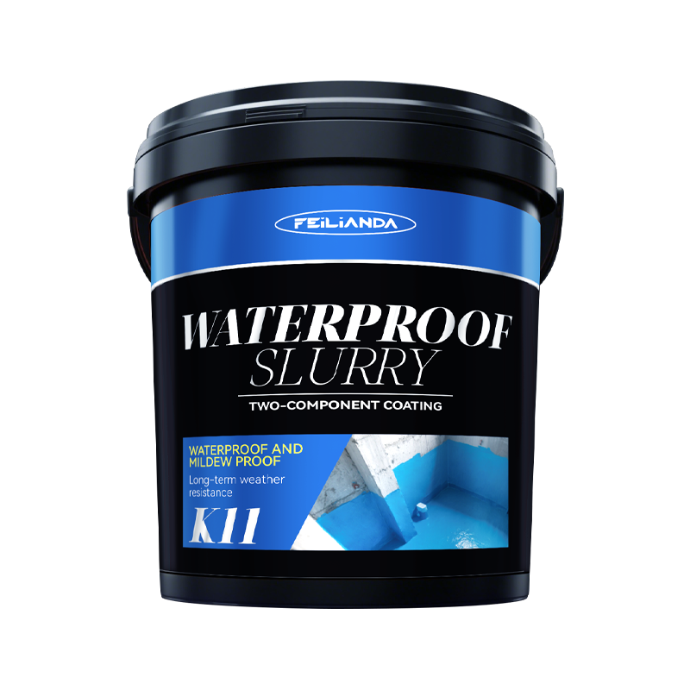
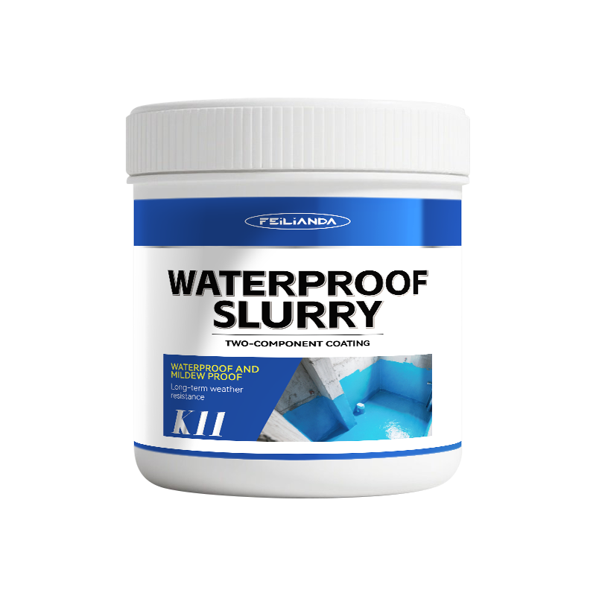
Datasheet
CONSTRUCTION
SOLUTIONS
WATERPROOFING
LAB™
K11 FEILIANDA K11 Waterproof Coating
Product Overview and Image
FEILIANDA K11 Waterproof Coating is a two-component polymer-modified cementitious waterproof material suitable for various indoor and outdoor applications. The product consists of high-performance cement, fine aggregates, and advanced polymer dispersion liquid, forming a dense, flexible, and durable waterproof membrane after curing. It is suitable for damp areas, basements, bathrooms, kitchens, balconies, terraces, and other structural parts requiring reliable waterproofing.
Features and Benefits
• High Adhesion: Bonds firmly to concrete, masonry, brick, and cement-based substrates. • Flexibility: Accommodates minor movement of the substrate without cracking. • Waterproofing: Forms an impermeable barrier to effectively prevent water penetration. • Durability: Resistant to abrasion, weak chemicals, and environmental stresses. • Easy Application: Can be applied with brushes, rollers, or spray equipment.
Uses
Suitable for horizontal and vertical surfaces in buildings that frequently or continuously come into contact with water, and can be used in both new construction and renovation projects. Examples: • Bathroom floors and walls before tile installation • Basement walls and slabs • Balcony and terrace surfaces • Interior of swimming pools
Version 3.2 of Datasheet K11 approved on Monday, 23 March 2026, 16:32:05 P.M. UTC+8
Page 1 of 4

Slide 2
Datasheet
CONSTRUCTION
SOLUTIONS
WATERPROOFING
LAB™
Typical Properties
Sizes: This product is packaged in drums, with sales packaging specifications available in four sizes: 3KG / 9KG / 18KG.
Available Colors: Blue
Clean Up: Skin Contact: Immediately wash thoroughly with soap and plenty of warm water. Avoid using solvents or harsh chemicals on skin. If irritation persists, seek medical advice. Eye Contact: Rinse eyes cautiously with clean running water for at least 15 minutes, lifting upper and lower eyelids occasionally. Remove contact lenses if present and easy to do. Seek immediate medical attention.
Application Methods: • Brushing is suitable for detailed or small-area work. • Rolling is suitable for large-area flat-surface application. • Spraying can use airless or air-assisted spray systems to increase speed and achieve uniform coverage.
Drying Time: Initial Set / Touch Dry: 2–4 hours Walkable: 6-8 hours Full Chemical & Mechanical Cure: 1–2 days Note: These times vary with temperature, humidity, and layer thickness.
Coverage Area: 1 kg of the product is expected to cover an area of approximately 0.5 square meters.
Construction Steps: Surface preparation: Remove dust, oil, loose particles, and contaminants from the surface. Ensure the substrate is firm, dry or slightly moist, but free of standing water. Primer (if needed): Apply a compatible primer as per manufacturer’s instructions to enhance adhesion. Mixing: Slowly add powder to the liquid component while stirring until a uniform, lump-free paste is formed. Mix only the amount needed for immediate use. Application: Evenly apply the first coat with a brush, roller, or spray equipment to reach the specified wet film thickness (typically 1.0 mm–1.5 mm), then allow it to dry. Second coat: After the recommended recoat interval, apply the second coat perpendicular to the first, maintaining consistent thickness. Final inspection: Check for pinholes or thin spots, repair if necessary, then allow full curing.
Maintenance Precautions
• Protect newly coated surfaces from mechanical damage during curing. • Avoid prolonged immersion in water before complete curing. • Regularly check for cracks or damage, and promptly repair with fresh K11 coating if found. • For maintenance cleaning, gently wash with clean water and mild detergent if needed.
Version 3.2 of Datasheet K11 approved on Monday, 23 March 2026, 16:32:05 P.M. UTC+8
Page 2 of 4

Slide 3



Datasheet
CONSTRUCTION
SOLUTIONS
WATERPROOFING
LAB™
Technical Parameters*
Appearance: After stirring, the liquid material is uniform and free of sediment.
Drying time (h): Surface dry / Fully dry ≤4/8 (test value: 2/8)
Impermeability pressure (MPa): ≥0.5 (test value: 2.7)
Flexibility (lateral deformation capacity) (mm): ≥2.0 (test value: 3.2)
Compressive strength (MPa): ≥12 (test value: 27)
Flexural strength (MPa): ≥4.0 (test value: 5.1)
Alkali resistance: No cracking or peeling
Heat resistance: No cracking or peeling
Freeze-thaw resistance: No cracking or peeling
Shrinkage rate (%): ≤0.3 (test value: <0.1)
* Provided by Wuxi Institute of Product Quality Supervision and Inspection, Jiangsu Province, China
Version 3.2 of Datasheet K11 approved on Monday, 23 March 2026, 16:32:05 P.M. UTC+8
Page 3 of 4

Slide 4
Datasheet
CONSTRUCTION
SOLUTIONS
WATERPROOFING
LAB™
Storage Conditions and Duration
Storage Temperature: Keep between +5°C and +45°C. Storage Environment: Store in a cool, dry, well-ventilated place away from direct sunlight and sources of heat. Packaging: Keep the product in its original sealed packaging to prevent contamination or moisture ingress. Shelf Life: 24 months from the date of manufacture when stored under recommended conditions. Safety Note: Keep out of reach of children and unauthorized personnel.
Disclaimer
This data sheet is copyrighted by Feilianda New Materials Co., Ltd. and/or Hangzhou Tianji Trading Co., Ltd. (collectively referred to as “Feilianda”). Without the prior written consent of Feilianda, this data sheet may not be modified or altered; if such modifications occur, Feilianda shall bear no responsibility or liability for them.
Unless Feilianda has provided you with a customized specification tailored to a specific project, this data sheet does not imply that any particular product or product system is suitable for your project.
All information provided in this data sheet is given in good faith, and Feilianda believes it to be correct at the time of publication. Provided that the substrate is in good condition, the coating is applied by personnel with appropriate experience and skills, and preparation, application, and maintenance are carried out strictly in accordance with the instructions or recommendations in this data sheet, the performance of the product and coating system is expected to meet the descriptions herein. Climatic conditions at the time of application may affect the suitability and performance of the product.
Correct color or color matching is the responsibility of the applicator. Colors may change over time, and Feilianda does not guarantee that a newly mixed color will match a previously applied color that has been exposed to weathering or other factors. No product color is guaranteed against color change.
To the extent that any liability of Feilianda related to this data sheet cannot be excluded by law, Feilianda’s liability, to the extent permitted by law and at its option, is limited to re-supplying the relevant products or services, or reimbursing the cost of such products or services.
Version 3.2 of Datasheet K11 approved on Monday, 23 March 2026, 16:32:05 P.M. UTC+8
Page 4 of 4

