Slide 1


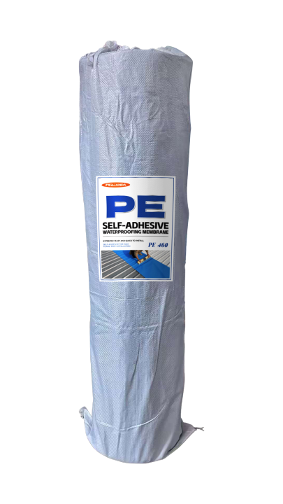
Datasheet
CONSTRUCTION
SOLUTIONS
WATERPROOFING
LAB™
PE 460 FEILIANDA PE Color Steel Roofing Insulation Film
Product Overview and Image
FEILIANDA PE Color Steel Roofing Insulation Film is a high-performance multi-layer composite membrane designed specifically for the surface protection and thermal management of color steel tile roofs. The product is composed of a PE base layer combined with functional materials, offering excellent waterproofing and heat insulation properties. Its structure is capable of resisting environmental stress, UV exposure, and mechanical damage, while maintaining long-term stable performance in sloped metal roofing systems.
Features and Benefits
Waterproof Performance: Multi-layer structure forms a continuous barrier against water ingress, effectively preventing leaks from rain or condensation. Heat Insulation: Reflective and low-emissivity layers reduce solar heat absorption, helping to lower interior temperatures. Durability: Resistant to aging, corrosion, and physical impact, suitable for outdoor long-term use. Adhesion Compatibility: Surface treatment allows strong bonding with most color steel tile substrates using appropriate adhesives or sealants. Lightweight & Flexible: Easy to handle, cut, and install without adding significant load to the roof structure. UV Resistance: Maintains stability and performance under prolonged sun exposure.
Uses
Application Scenarios: Roof waterproofing and heat insulation for industrial and commercial buildings. Renovation projects where existing color steel tile roofs need improved weather resistance. Agricultural structures such as barns, greenhouses, and storage sheds. Temporary or semi-permanent protective covers in construction sites. Example Scenarios: A factory warehouse with a corrugated color steel roof suffering from water leakage during heavy rain. A logistics center requiring temperature control in storage areas to protect goods. An agricultural greenhouse needing to reduce heat buildup in summer while keeping the interior dry.
Version 3.2 of Datasheet PE 460 approved on Monday, 23 March 2026, 16:47:22 P.M. UTC+8
Page 1 of 4

Slide 2
Datasheet
CONSTRUCTION
SOLUTIONS
WATERPROOFING
LAB™
Typical Properties
Sizes: This product is packaged in drums, with sales packaging specifications available in four sizes: 30㎡ / 50㎡ / 100㎡.
Available Colors: Red Silver Blue Gray
Clean Up: After application, simply wash hands with clean water.
Application Methods: No need for torch heating—self-adhesive, just peel and stick, making installation easy.
Drying Time: None.
Coverage Area: None.
Construction Steps: Surface Preparation – Ensure substrate is clean, dry, and free from dust, oil, grease, loose particles, and contaminants. Repair cracks larger than 0.5 mm before coating. Film Cutting: Measure and cut the roll film to the required size, allowing for overlap at edges and joints. Laying the Film: Unroll the film over the prepared surface, aligning carefully. Use a roller to press down firmly, starting from one end to avoid bubbles. Seam Sealing: Overlap adjacent pieces by at least 50 mm and seal the seams with a compatible sealing tape or adhesive. Edge Fixing: Secure the film edges with mechanical fasteners or adhesive to prevent lifting. Final Inspection: Check for wrinkles, gaps, or weak spots; re-press or repair as needed.
Maintenance Precautions
Conduct regular visual inspections, especially after extreme weather events. Clean surface debris periodically to prevent abrasion or moisture retention. Repair minor damages promptly using patch kits or additional film sections. Avoid walking directly on the film-covered surface; use walkways or protective boards if access is necessary.
Storage Conditions and Duration
Storage Temperature: Keep between -10°C and +120°C. Storage Environment: Store in a cool, dry, well-ventilated place away from direct sunlight and sources of heat. Packaging: Keep the product in its original sealed packaging to prevent contamination or moisture ingress. Shelf Life: 36 months from the date of manufacture when stored under recommended conditions. Safety Note: Keep out of reach of children and unauthorized personnel.
Version 3.2 of Datasheet PE 460 approved on Monday, 23 March 2026, 16:47:22 P.M. UTC+8
Page 2 of 4

Slide 3



Datasheet
CONSTRUCTION
SOLUTIONS
WATERPROOFING
LAB™
Technical Parameters*
Maximum tensile force (N/50 mm): Longitudinal: 305 Transverse: 262
Tear performance (N): Longitudinal: 18 Transverse: 15
Heat resistance: 72°C, 2 h, no flow or dripping
Water impermeability: 1 m water column, 24 h, no water penetration
Low-temperature bending: -45°C, 2 h, no cracks
* Provided by NATIONAL CENTER FORQUALITY SUPERVISIONAND TEST OF BUILDING ENGINEERING CHINA
Version 3.2 of Datasheet PE 460 approved on Monday, 23 March 2026, 16:47:22 P.M. UTC+8
Page 3 of 4

Slide 4
Datasheet
CONSTRUCTION
SOLUTIONS
WATERPROOFING
LAB™
Disclaimer
This data sheet is copyrighted by Feilianda New Materials Co., Ltd. and/or Hangzhou Tianji Trading Co., Ltd. (collectively referred to as “Feilianda”). Without the prior written consent of Feilianda, this data sheet may not be modified or altered; if such modifications occur, Feilianda shall bear no responsibility or liability for them.
Unless Feilianda has provided you with a customized specification tailored to a specific project, this data sheet does not imply that any particular product or product system is suitable for your project.
All information provided in this data sheet is given in good faith, and Feilianda believes it to be correct at the time of publication. Provided that the substrate is in good condition, the coating is applied by personnel with appropriate experience and skills, and preparation, application, and maintenance are carried out strictly in accordance with the instructions or recommendations in this data sheet, the performance of the product and coating system is expected to meet the descriptions herein. Climatic conditions at the time of application may affect the suitability and performance of the product.
Correct color or color matching is the responsibility of the applicator. Colors may change over time, and Feilianda does not guarantee that a newly mixed color will match a previously applied color that has been exposed to weathering or other factors. No product color is guaranteed against color change.
To the extent that any liability of Feilianda related to this data sheet cannot be excluded by law, Feilianda’s liability, to the extent permitted by law and at its option, is limited to re-supplying the relevant products or services, or reimbursing the cost of such products or services.
Version 3.2 of Datasheet PE 460 approved on Monday, 23 March 2026, 16:47:22 P.M. UTC+8
Page 4 of 4

