Slide 1


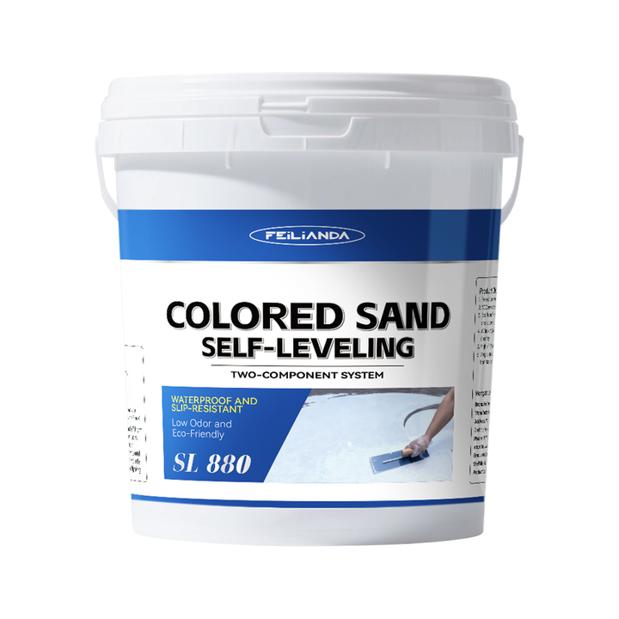
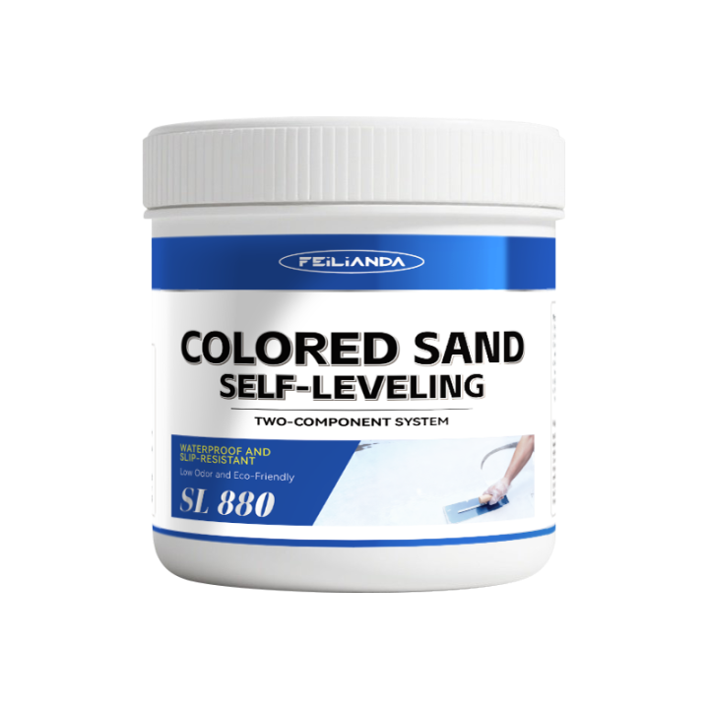
Datasheet
CONSTRUCTION
SOLUTIONS
DR. FLOOR PAINT
LAB™
SL 880 FEILIANDA Colored Sand Self-Leveling
Product Overview and Image
FEILIANDA Colored Sand Self-Leveling is a two-component, solvent-free, high-performance floor finishing system that combines the chemical resistance and mechanical strength of epoxy resin with the aesthetic appeal of colored sand aggregates. Designed for both commercial and industrial applications, it provides a smooth, durable, and visually attractive surface that can withstand heavy foot traffic, light to moderate vehicular loads, and various chemical exposures. The self-leveling property ensures an even, flat finish without the need for extensive manual troweling, making it ideal for large area coverage.
Features and Benefits
High Mechanical Strength: Excellent compressive, flexural, and impact resistance. Chemical Resistance: Resists oils, mild acids, alkalis, solvents, and cleaning agents. Aesthetic Customization: Available in multiple color options with natural or synthetic sand textures. Seamless Surface: No joints, reducing dirt accumulation and improving hygiene. Slip Resistance (optional): Can be adjusted by varying sand size and content. Good Adhesion: Bonds well to properly prepared concrete, cement screed, and some existing coatings. Fast Curing: Short drying time allows for quick project turnaround.
Uses
Scenarios: Industrial plants, warehouses, and logistics centers. Commercial areas such as shopping malls, showrooms, and office lobbies. Public facilities like schools, hospitals, and sports arenas. Parking decks and underground garages. Food processing and pharmaceutical production areas (when formulated to meet hygienic standards). Examples: Warehouse flooring for automotive parts storage requiring abrasion resistance. Shopping mall corridor flooring needing decorative appeal and durability. Hospital sterile zones where cleanliness and chemical resistance are critical.
Version 3.2 of Datasheet SL 880 approved on Monday, 23 March 2026, 17:00:45 P.M. UTC+8
Page 1 of 4

Slide 2
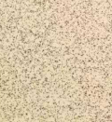
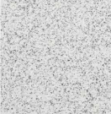
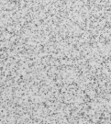
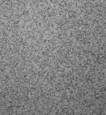
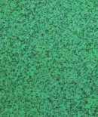
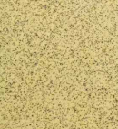
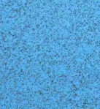

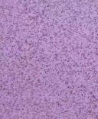
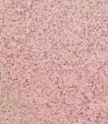
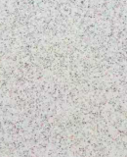
Datasheet
CONSTRUCTION
SOLUTIONS
DR. FLOOR PAINT
LAB™
Typical Properties
Sizes: This product is packaged in drums, with sales packaging specifications available in four sizes: 0.8KG / 1.6KG / 8KG / 16KG/ 32KG.
Available Colors: Beige White Sand Grey Sesame Grey Sea Grey Fruit Green Lemon Yellow Baby Blue Sky Blue Sunset Purple Pink Multi Color
Clean Up: Skin Contact: Immediately wash thoroughly with soap and plenty of warm water. Avoid using solvents or harsh chemicals on skin. If irritation persists, seek medical advice. Eye Contact: Rinse eyes cautiously with clean running water for at least 15 minutes, lifting upper and lower eyelids occasionally. Remove contact lenses if present and easy to do. Seek immediate medical attention.
Application Methods: Squeegee/Notched Trowel: For larger areas, use a notched squeegee followed by a spiked roller to ensure even distribution. Pouring/Self-leveling: Pour the mixed compound onto the substrate; it will flow and level under gravity. Trowel Finishing: For textured or non-smooth finishes, use a steel trowel after initial set.
Drying Time: Initial Set / Touch Dry: 8–12 hours Walkable: 12–24 hours Full Chemical & Mechanical Cure: 5–7 days Note: These times vary with temperature, humidity, and layer thickness.
Coverage Area: 1 kg of the product is expected to cover an area of approximately 0.6 square meters.
Construction Steps: Surface Preparation: Clean thoroughly; remove dust, oil, grease, and loose material. Repair cracks and holes. Priming (if required): On very porous surfaces, apply a thin coat of compatible primer and let dry. Mixing: Combine Part A (resin) and Part B (hardener) in the correct ratio. Mix thoroughly with a power mixer for 2–3 minutes until uniform. Pouring: Pour the mixture onto the primed surface. Use a notched squeegee to spread and a spiked roller to remove air bubbles. Leveling: Let the material self-level. Do not walk on the surface during this period. Curing: Allow the material to cure undisturbed. Protect from dust and moisture. Final Inspection: After full cure, inspect for imperfections. Light sanding may be done if needed before applying sealers or topcoats.
Maintenance Precautions
Regular Cleaning: Sweep or vacuum daily to remove debris. Mop with neutral pH detergents. Spill Management: Wipe up spills immediately to prevent staining or chemical attack. Polishing (Optional): Periodic buffing with a soft pad can restore gloss. Re-coating: Depending on wear, apply a thin topcoat every 3–5 years to maintain protection and appearance. Avoid Harsh Chemicals: Do not use strong acids, bases, or abrasive cleaners.
Version 3.2 of Datasheet SL 880 approved on Monday, 23 March 2026, 17:00:45 P.M. UTC+8
Page 2 of 4

Slide 3



Datasheet
CONSTRUCTION
SOLUTIONS
DR. FLOOR PAINT
LAB™
Technical Parameters*
Surface drying time (h): ≤8 (test value: 6)
Full drying time (h): ≤48 (test value: 24)
Shore hardness (Type D): 76
Abrasion resistance (750 g / 500 r) (g): ≤0.050 (test value: 0.023)
Impact resistance [heavy load (1000 g steel ball)]: No cracking or peeling of the paint film
Water resistance (168 h): No blistering, peeling, or discoloration
Water resistance (168 h): No blistering, peeling, or discoloration.
Chemical resistance: Oil resistance (120# solvent gasoline, 72 h): No blistering, peeling, or discoloration
* Provided byThe Quality Supervision and Inspection Center or syntheticMaterial Ageing of Chemical Industry, China
Version 3.2 of Datasheet SL 880 approved on Monday, 23 March 2026, 17:00:45 P.M. UTC+8
Page 3 of 4

Slide 4
Datasheet
CONSTRUCTION
SOLUTIONS
DR. FLOOR PAINT
LAB™
Storage Conditions and Duration
Storage Temperature: Keep between +5°C and +45°C. Storage Environment: Store in a cool, dry, well-ventilated place away from direct sunlight and sources of heat. Packaging: Keep the product in its original sealed packaging to prevent contamination or moisture ingress. Shelf Life: 18 months from the date of manufacture when stored under recommended conditions. Safety Note: Keep out of reach of children and unauthorized personnel.
Disclaimer
This data sheet is copyrighted by Feilianda New Materials Co., Ltd. and/or Hangzhou Tianji Trading Co., Ltd. (collectively referred to as “Feilianda”). Without the prior written consent of Feilianda, this data sheet may not be modified or altered; if such modifications occur, Feilianda shall bear no responsibility or liability for them.
Unless Feilianda has provided you with a customized specification tailored to a specific project, this data sheet does not imply that any particular product or product system is suitable for your project.
All information provided in this data sheet is given in good faith, and Feilianda believes it to be correct at the time of publication. Provided that the substrate is in good condition, the coating is applied by personnel with appropriate experience and skills, and preparation, application, and maintenance are carried out strictly in accordance with the instructions or recommendations in this data sheet, the performance of the product and coating system is expected to meet the descriptions herein. Climatic conditions at the time of application may affect the suitability and performance of the product.
Correct color or color matching is the responsibility of the applicator. Colors may change over time, and Feilianda does not guarantee that a newly mixed color will match a previously applied color that has been exposed to weathering or other factors. No product color is guaranteed against color change.
To the extent that any liability of Feilianda related to this data sheet cannot be excluded by law, Feilianda’s liability, to the extent permitted by law and at its option, is limited to re-supplying the relevant products or services, or reimbursing the cost of such products or services.
Version 3.2 of Datasheet SL 880 approved on Monday, 23 March 2026, 17:00:45 P.M. UTC+8
Page 4 of 4

