Slide 1


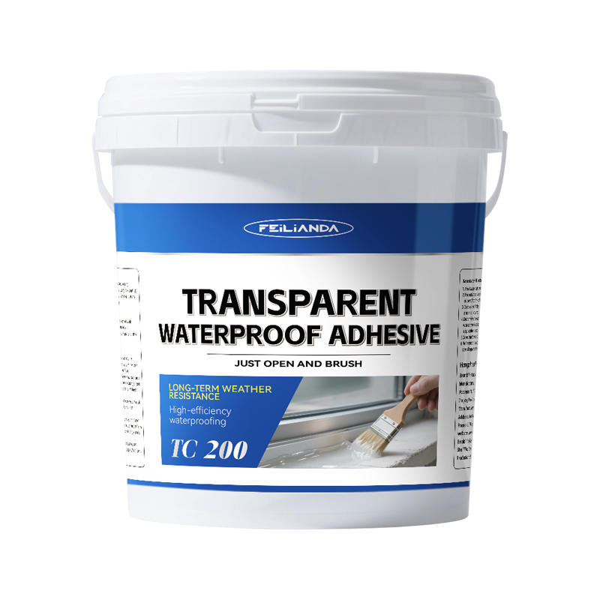
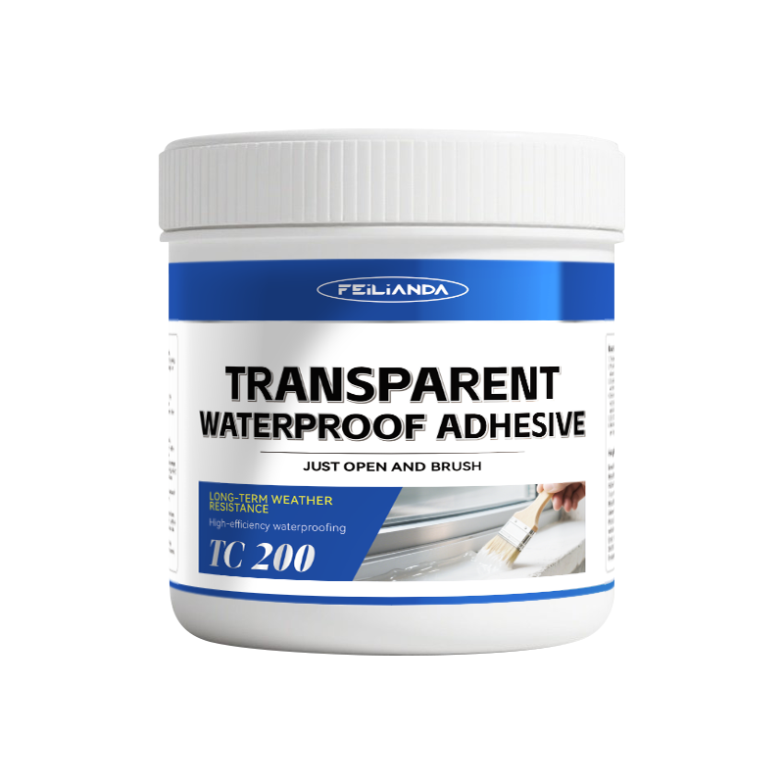
Datasheet
CONSTRUCTION
SOLUTIONS
WATERPROOFING
LAB™
TC 200 FEILIANDA Transparent Waterproof Adhesive
Product Overview and Image
FEILIANDA Transparent Waterproof Adhesive is a high-performance single-component transparent waterproof coating, formulated with water-based polymer and a well-balanced additive system. It features excellent repair capability, convenient application (ready-to-use straight from the bucket), and long-lasting weather and aging resistance. Designed to form a transparent, flexible, and durable waterproof barrier on various building surfaces, it does not alter the original appearance or color of the surface. The product cures through moisture in the air, forming a continuous film layer that resists water penetration while possessing sufficient flexibility to accommodate slight movement of the substrate.
Features and Benefits
High Transparency: Maintains the natural look of the substrate after application. Strong Adhesion: Bonds effectively to multiple building materials without primer in most cases. Weather Resistance: Withstands UV exposure, rain, temperature fluctuations, and mild chemical contact. Flexibility: Accommodates minor expansion and contraction of building materials. Waterproof Performance: Forms a seamless barrier against water ingress. Non-yellowing: Retains clarity over time under normal environmental conditions.
Uses
Usage Scenario Overview: Suitable for sealing joints, cracks, and penetrations that require waterproofing while maintaining visual transparency. Commonly used on building exterior walls, window sills, and pool edges. Examples: • Waterproofing around window frames and door openings while keeping the frames visible. • Protecting the grout lines of exterior wall tiles without altering their color.
Version 3.2 of Datasheet TC 200 approved on Monday, 23 March 2026, 17:13:14 P.M. UTC+8
Page 1 of 4

Slide 2
Datasheet
CONSTRUCTION
SOLUTIONS
WATERPROOFING
LAB™
Typical Properties
Sizes: This product is packaged in drums, with sales packaging specifications available in four sizes: 0.5KG/1KG/5KG/10KG/20KG.
Available Colors: Transparent
Clean Up: Skin Contact: Immediately wash thoroughly with soap and plenty of warm water. Avoid using solvents or harsh chemicals on skin. If irritation persists, seek medical advice. Eye Contact: Rinse eyes cautiously with clean running water for at least 15 minutes, lifting upper and lower eyelids occasionally. Remove contact lenses if present and easy to do. Seek immediate medical attention.
Application Methods: Manual brush Roller coating Airless spray (with appropriate nozzle size)
Drying Time: Surface Dry: Approximately 2–4 hours. Touch Dry: About 3–4 hours under standard conditions. Full Cure: Typically 24–48 hours depending on thickness and ambient conditions. Lower temperatures or higher humidity may extend curing time. Note: These times vary with temperature, humidity, and layer thickness.
Coverage Area: 1 kg of the product is expected to cover an area of approximately 4 square meters.
Construction Steps: Surface preparation: Thoroughly clean the substrate to remove dust, oil, grease, loose particles, and other contaminants. Ensure the substrate is dry before application. Primer (if needed): Apply the recommended primer on porous substrates to enhance adhesion. Allow the primer to dry to touch. Application: Apply the sealant evenly using a brush, roller, or spray according to the specified wet film thickness. For joints, fill completely to ensure no voids. Curing: Allow sufficient drying and curing time before exposure to water or mechanical stress.
Maintenance Precautions
• Regularly inspect the coated areas for signs of damage, cracking, or peeling. • Clean the surface gently using non-abrasive methods to avoid damaging the waterproof layer. • For damaged or worn areas, reapply the waterproof adhesive following the same preparation and application steps.
Version 3.2 of Datasheet TC 200 approved on Monday, 23 March 2026, 17:13:14 P.M. UTC+8
Page 2 of 4

Slide 3



Datasheet
CONSTRUCTION
SOLUTIONS
WATERPROOFING
LAB™
Technical Parameters*
Benzene (g/kg): ≤0.20 (not detected)
Toluene + ethylbenzene + xylenes (g/kg): ≤10 (not detected)
Volatile organic compounds (g/kg): ≤350 (test value: 4)
Free formaldehyde (g/kg): ≤1 (not detected)
* Provided by Jiangsu Institute of Product Quality Supervision and Inspection, China
Version 3.2 of Datasheet TC 200 approved on Monday, 23 March 2026, 17:13:14 P.M. UTC+8
Page 3 of 4

Slide 4
Datasheet
CONSTRUCTION
SOLUTIONS
WATERPROOFING
LAB™
Storage Conditions and Duration
Storage Temperature: Keep between +5°C and +45°C. Storage Environment: Store in a cool, dry, well-ventilated place away from direct sunlight and sources of heat. Packaging: Keep the product in its original sealed packaging to prevent contamination or moisture ingress. Shelf Life: 24 months from the date of manufacture when stored under recommended conditions. Safety Note: Keep out of reach of children and unauthorized personnel.
Disclaimer
This data sheet is copyrighted by Feilianda New Materials Co., Ltd. and/or Hangzhou Tianji Trading Co., Ltd. (collectively referred to as “Feilianda”). Without the prior written consent of Feilianda, this data sheet may not be modified or altered; if such modifications occur, Feilianda shall bear no responsibility or liability for them.
Unless Feilianda has provided you with a customized specification tailored to a specific project, this data sheet does not imply that any particular product or product system is suitable for your project.
All information provided in this data sheet is given in good faith, and Feilianda believes it to be correct at the time of publication. Provided that the substrate is in good condition, the coating is applied by personnel with appropriate experience and skills, and preparation, application, and maintenance are carried out strictly in accordance with the instructions or recommendations in this data sheet, the performance of the product and coating system is expected to meet the descriptions herein. Climatic conditions at the time of application may affect the suitability and performance of the product.
Correct color or color matching is the responsibility of the applicator. Colors may change over time, and Feilianda does not guarantee that a newly mixed color will match a previously applied color that has been exposed to weathering or other factors. No product color is guaranteed against color change.
To the extent that any liability of Feilianda related to this data sheet cannot be excluded by law, Feilianda’s liability, to the extent permitted by law and at its option, is limited to re-supplying the relevant products or services, or reimbursing the cost of such products or services.
Version 3.2 of Datasheet TC 200 approved on Monday, 23 March 2026, 17:13:14 P.M. UTC+8
Page 4 of 4

