Slide 1


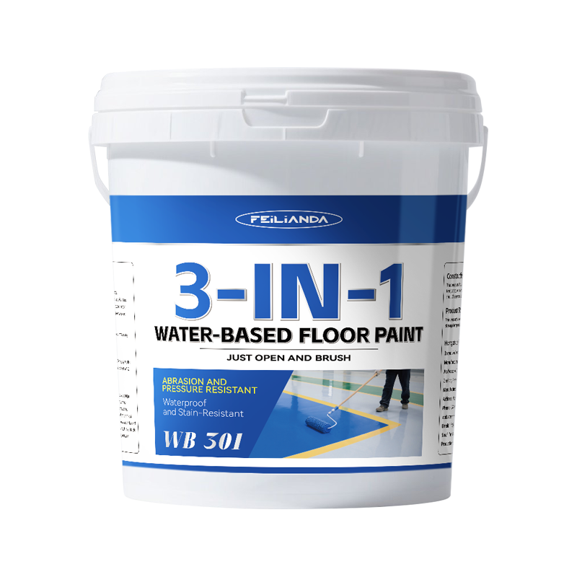
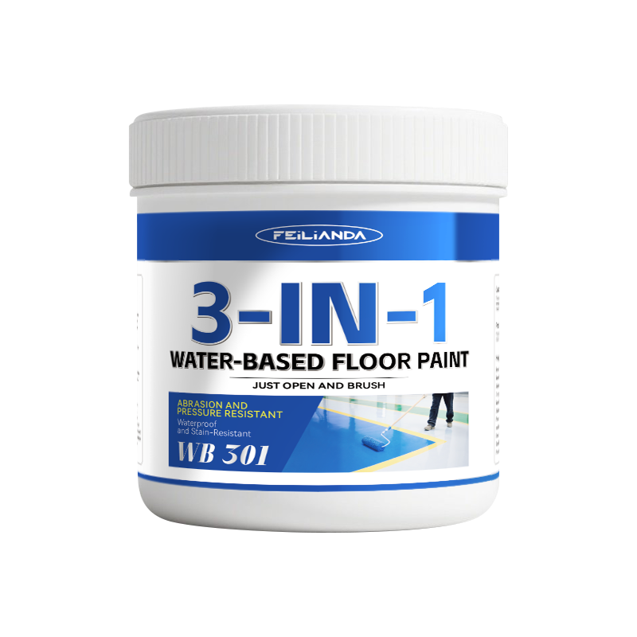
Datasheet
CONSTRUCTION
SOLUTIONS
DR. FLOOR PAINT
LAB™
WB 301 FEILIANDA 3-in-1 Water-Based Floor Paint
Product Overview and Image
FEILIANDA 3-in-1 Water-Based Floor Paint is a high-performance, water-based floor coating system designed to provide a durable, smooth, and aesthetically pleasing surface for various indoor and semi-outdoor flooring applications. It combines the functions of primer, base coat, and topcoat in a single product, streamlining the application process while ensuring long-term performance. The formulation is based on advanced waterborne polymer technology, delivering strong adhesion, impact resistance, and easy cleanability.
Features and Benefits
Integrated three-in-one function: acts as primer, base coat, and topcoat, reducing material usage and labor time. Excellent adhesion​ to concrete, cement screed, and other mineral substrates. High wear resistance​ and scratch resistance for long service life. Smooth, seamless finish​ that resists dust accumulation and is easy to maintain. Good chemical resistance​ against common industrial and commercial chemicals. Water-based formula​ for low odor and easy cleanup with water. Non-flammable during application, improving safety in enclosed spaces.
Uses
Suitable for:​ Warehouses and logistics centers Commercial showrooms and retail stores Light-industrial workshops Garages and car parks (indoor areas) Offices and public buildings School gymnasiums and sports halls Example Scenarios:​ A distribution center needing a hard-wearing, easy-to-clean floor for daily pallet movement. A boutique shop requiring an attractive, stain-resistant surface for foot traffic. An office interior where durability and minimal maintenance are priorities.
Version 3.2 of Datasheet WB 301 approved on Monday, 23 March 2026, 13:55:22 P.M. UTC+8
Page 1 of 4

Slide 2
Datasheet
CONSTRUCTION
SOLUTIONS
DR. FLOOR PAINT
LAB™
Typical Properties
Sizes: This product is packaged in drums, with sales packaging specifications available in four sizes: 0.5KG / 5KG / 10KG / 20KG.
Available Colors: Light Gray Medium Gray Beige Lemon Yellow Medium Yellow Bright Red Iron Brown Coffee Brown Light Blue Dark Blue White Apple Green Emerald Green Black
Clean Up: Skin contact: Immediately rinse with plenty of clean water and mild soap. Avoid using solvents. If irritation persists, seek medical attention. Eye contact: Rinse immediately with copious amounts of clean water for at least 15 minutes. Remove contact lenses if easily possible. Seek medical advice promptly.
Application Methods: Roller: Use medium-nap synthetic roller for even film formation. Brush: Suitable for edges, corners, and small areas. Spray: Airless spray system recommended for large areas; ensure proper ventilation and PPE. Trowel/Notched Trowel: For textured finishes or when embedding anti-slip aggregates
Drying Time: Touch Dry: Approx. 1–2 hours. Recoat Time: Minimum 4 hours, maximum 24 hours. Full Cure: 7 days (for full chemical and mechanical resistance). Note: Lower temperature and higher humidity will extend drying times.
Coverage Area: 1 kg of the product is expected to cover an area of approximately 3 square meters.
Construction Steps: Surface Preparation: Clean thoroughly; remove dust, oil, grease, and loose material. Repair cracks and holes. Priming (if required): On very porous surfaces, apply a thin coat of compatible primer and let dry. Mixing: Stir the paint well before use. Do not shake to avoid air bubbles. First Coat: Apply evenly using roller, brush, or spray. Ensure complete coverage. Drying: Allow to reach touch-dry state (1–2 hours). Second Coat: Apply second coat in perpendicular direction to first for uniform finish. Final Inspection: Check for pinholes, runs, or missed spots; apply third coat if necessary. Curing: Avoid heavy traffic and chemical exposure for at least 7 days.
Maintenance Precautions
Initial 7 Days: Protect from water, chemicals, and heavy loads. Regular Cleaning: Sweep daily; mop weekly with neutral pH detergent. Stain Removal: Blot spills immediately; use appropriate cleaners for specific stains. Re-coating: Reapply a maintenance coat every 3–5 years depending on traffic and wear. Avoid: Harsh abrasives, strong solvents, and steel wool that can damage the surface.
Version 3.2 of Datasheet WB 301 approved on Monday, 23 March 2026, 13:55:22 P.M. UTC+8
Page 2 of 4

Slide 3



Datasheet
CONSTRUCTION
SOLUTIONS
DR. FLOOR PAINT
LAB™
Technical Parameters*
State in container: Paint: Uniform after stirring and mixing, free from hard lumps. Hardener: Uniform after stirring and mixing, free from hard lumps.
Film appearance: Normal appearance.
Drying time (h): Surface dry ≤8 (actual test: surface dry at 0.5h) Fully dry ≤48 (actual test: fully dry at 3h)
Shore hardness (Pencil scratch hardness): B
Abrasion resistance (750 g / 500 r), g: ≤0.050 (test value: 0.015)
Impact resistance [heavy load (1000 g steel ball)]: No cracking or peeling of the paint film
Water resistance (168 h): No blistering, peeling, or discoloration.
Chemical resistance: Oil resistance (120# solvent gasoline, 72 h): No blistering, peeling, or discoloration. Alkali resistance (20% NaOH, 72 h): No blistering, peeling, or discoloration.
* Provided byZhejiang Ningbo Institute of Product and Food Quality Inspection, China
Version 3.2 of Datasheet WB 301 approved on Monday, 23 March 2026, 13:55:22 P.M. UTC+8
Page 3 of 4

Slide 4
Datasheet
CONSTRUCTION
SOLUTIONS
DR. FLOOR PAINT
LAB™
Storage Conditions and Duration
Storage Temperature: Keep between +5°C and +45°C. Storage Environment: Store in a cool, dry, well-ventilated place away from direct sunlight and sources of heat. Packaging: Keep the product in its original sealed packaging to prevent contamination or moisture ingress. Shelf Life: 18 months from the date of manufacture when stored under recommended conditions. Safety Note: Keep out of reach of children and unauthorized personnel.
Disclaimer
This data sheet is copyrighted by Feilianda New Materials Co., Ltd. and/or Hangzhou Tianji Trading Co., Ltd. (collectively referred to as “Feilianda”). Without the prior written consent of Feilianda, this data sheet may not be modified or altered; if such modifications occur, Feilianda shall bear no responsibility or liability for them.
Unless Feilianda has provided you with a customized specification tailored to a specific project, this data sheet does not imply that any particular product or product system is suitable for your project.
All information provided in this data sheet is given in good faith, and Feilianda believes it to be correct at the time of publication. Provided that the substrate is in good condition, the coating is applied by personnel with appropriate experience and skills, and preparation, application, and maintenance are carried out strictly in accordance with the instructions or recommendations in this data sheet, the performance of the product and coating system is expected to meet the descriptions herein. Climatic conditions at the time of application may affect the suitability and performance of the product.
Correct color or color matching is the responsibility of the applicator. Colors may change over time, and Feilianda does not guarantee that a newly mixed color will match a previously applied color that has been exposed to weathering or other factors. No product color is guaranteed against color change.
To the extent that any liability of Feilianda related to this data sheet cannot be excluded by law, Feilianda’s liability, to the extent permitted by law and at its option, is limited to re-supplying the relevant products or services, or reimbursing the cost of such products or services.
Version 3.2 of Datasheet WB 301 approved on Monday, 23 March 2026, 13:55:22 P.M. UTC+8
Page 4 of 4

